Slide 1




Slide 2

Outline
Executive Summary​
Introduction​
Methodology​
Results​
Visualization – Charts​
Dashboard​
Discussion​
Findings & Implications​
Conclusion​
Appendix

Slide 3
Executive Summary
This project used open-source data collected from the SpaceX API and SpaceX Wikipedia page.​
Exploratory analysis conducted with using SQL, visualization, folium maps, and dashboarding.​
Gathered relevant columns to be used as features during data cleaning​
Four machine learning models were produced;​
Logistic Regression, Support Vector Machine, Decision Tree Classifier, and K Nearest Neighbors​
The best model achieved 88.9% accuracy.

Slide 4
Introduction
Background:​
Commercial space flight has proliferated​
Space X claims best value for money ($62 million vs. $165 million USD)​
Space X have considerably lower cost due to reusable part of rocket (Stage 1)​
Space Y wants to compete with Space X​
ML Problem:​
Space Y tasks us to train a machine learning model to predict successful Stage 1 recovery

Slide 5


Slide 6
Methodology
Executive Summary
Data collection methodology:
Data collection combined open-source data from SpaceX public API and SpaceX Wikipedia page
Performed data wrangling
We converted landing outcomes to Classes
Perform exploratory data analysis (EDA) using visualization and SQL
Perform interactive visual analytics using Folium and Plotly Dash
Perform predictive analysis using classification models
Predictive analysis carried out using classification models ​
Logistic Regression, Support Vector Machine, Decision Tree Classifier, and K Nearest Neighbors​
Tuned models using GridSearchCV

Slide 7
Data Collection
Data collection combined open-source data from SpaceX public API and SpaceX Wikipedia page

Slide 8
Data Collection – SpaceX API
Present your data collection with SpaceX REST calls using key phrases and flowcharts
https://github.com/pdee-design/IDM-data-science/blob/8943b592acb04f48449b8eb072700dfe2ab1b21a/Data%20collection.ipynb
Request (Space X APIs)
Filter data to only include Falcon 9 launches
Imputate missing PayloadMass values with mean
.JSON file + Lists(Launch Site, Booster Version, Payload Data)
Cast dictionary to a DataFrame
Json_normalize to DataFrame data from JSON
Dictionary relevant data

Slide 9
Data Collection - Scraping
Open-source data scraped from SpaceX public API and SpaceX Wikipedia page
https://github.com/pdee-design/IDM-data-science/blob/8943b592acb04f48449b8eb072700dfe2ab1b21a/web%20scrapping.ipynb
Request Wikipedia
html
Cast dictionary to DataFrame
Iterate through table cells to extract data to dictionary
BeautifulSoup
html5lib Parser
Find launch info html table
Create dictionary

Slide 10
Data Wrangling
Data cleaned, NaN values of payloadmass replaced with mean
Calc number and type of orbit
Perform exploratory data analysis & Visualizations
Calc type of orbit and outcome of mission
https://github.com/pdee-design/IDM-data-science/blob/8943b592acb04f48449b8eb072700dfe2ab1b21a/eda.ipynb
Calc number of launches at each site
Create outcome labels

Slide 11
EDA with Data Visualization
Exploratory Data Analysis performed on variables Flight Number, Payload Mass, Launch Site, Orbit, Class and Year.
Plots Used:
Flight Number vs. Payload Mass, Flight Number vs. Launch Site, Payload Mass vs. Launch Site, Orbit vs. Success Rate, Flight Number vs. Orbit, Payload vs Orbit, and Success Yearly Trend
Scatter plots, line charts, and bar plots were used to compare relationships between variables to
decide if a relationship exists so that they could be used in training the machine learning model
https://github.com/pdee-design/IDM-data-science/blob/8943b592acb04f48449b8eb072700dfe2ab1b21a/eda%20with%20visualization.ipynb

Slide 12
EDA with SQL
Loaded data set into IBM DB2 Database.
Queried using SQL Python integration.
Queries were made to get a better understanding of the dataset.
Queried information about launch site names, mission outcomes, various pay load sizes of customers and booster versions, and landing outcomes
https://github.com/pdee-design/IDM-data-science/blob/8943b592acb04f48449b8eb072700dfe2ab1b21a/eda%20sql.ipynb

Slide 13
Build an Interactive Map with Folium
Folium maps mark Launch Sites, successful and unsuccessful landings, and a proximity example to key locations: Railway, Highway, Coast, and City.
This allows us to understand why launch sites may be located where they are. Also visualizes successful landings relative to location.
Add the GitHub URL of your completed interactive map with Folium map, as an external reference and peer-review purpose

Slide 14
Build a Dashboard with Plotly Dash
Dashboard includes a pie chart and a scatter plot.
Pie chart can be selected to show distribution of successful landings across all launch sites and can be selected to show individual launch site success rates.
Scatter plot takes two inputs: All sites or individual site and payload mass on a slider between 0 and 10000 kg.
The pie chart is used to visualize launch site success rate.
The scatter plot can help us see how success varies across launch sites, payload mass, and
Booster version category.
Add the GitHub URL of your completed Plotly Dash lab, as an external reference and peer-review purpose

Slide 15
Predictive Analysis (Classification)
Predictive analysis carried out using classification models ​
Logistic Regression, Support Vector Machine, Decision Tree Classifier, and K Nearest Neighbors​
Tuned models using GridSearchCV
Add the GitHub URL
Split label column
Score models on
Confusion Matrix
‘Class’ from dataset
split test set
for all models
Fit and Transform
Use GridSearchCV
Features using
on LogReg, SVM,
Barplot to compare scores of models
Standard Scaler
Decision Tree, and
KNN models
Train_test_split
GridSearchCV
data
(cv=10) to find optimal parameters

Slide 16
Results
Exploratory data analysis results
Interactive analytics demo in screenshots
Predictive analysis results

Slide 17


Slide 18
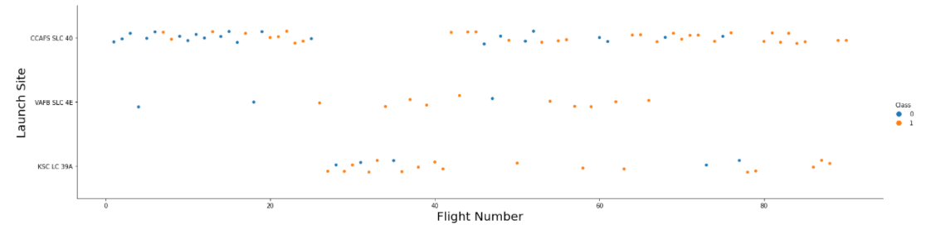
Flight Number vs. Launch Site
Show a scatter plot of Flight Number vs. Launch Site
Show the screenshot of the scatter plot with explanations
Positive correlation between number of flights at a site and success rate of that site.

Slide 19
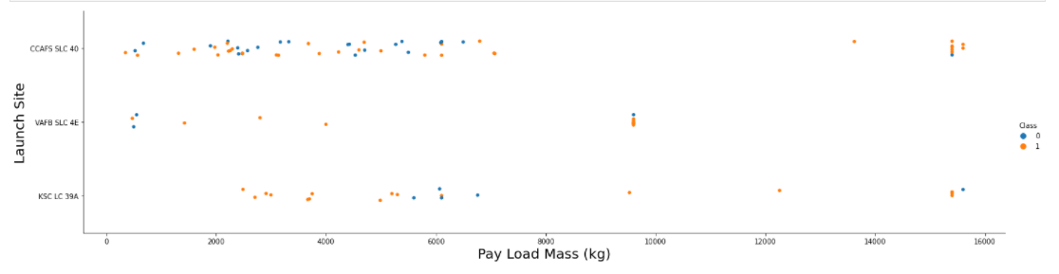
Payload vs. Launch Site
Positive correlation between mass of payload and successful outcome of launch

Slide 20
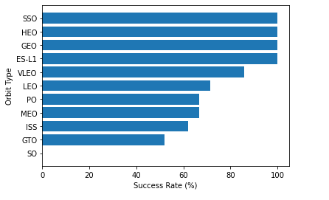
Success Rate vs. Orbit Type
The GEO, HEO, SSO and ES-l1 orbits had the most successful launches

Slide 21
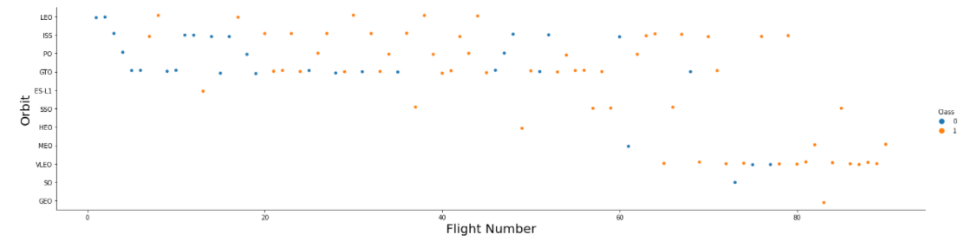
Flight Number vs. Orbit Type
A positive correlation between the number of flights and mission success.

Slide 22
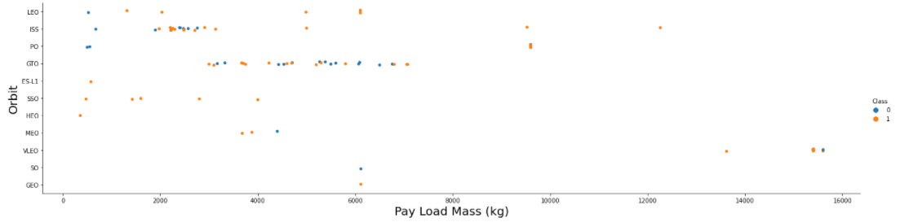
Payload vs. Orbit Type
Payload weight has a negative correlation with mission success for GTO, but a positive correlation with mission success for LEO and ISS.

Slide 23
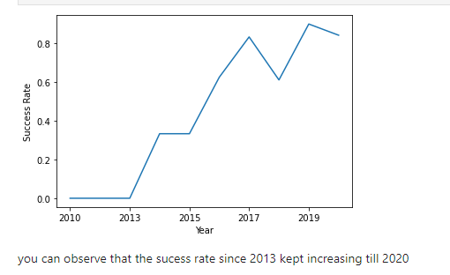
Launch Success Yearly Trend
The success rate had been improving from 2013 to 2019, but has since declined

Slide 24
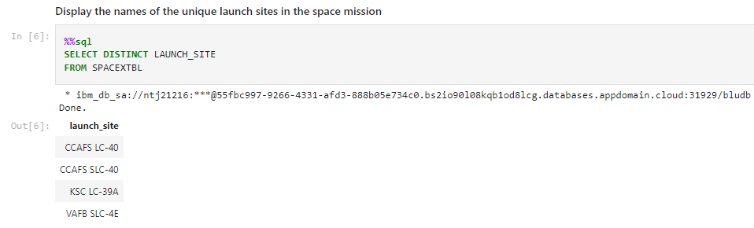
All Launch Site Names
Using DISTINCT means the query will only return unique values in the Launch_Site column

Slide 25
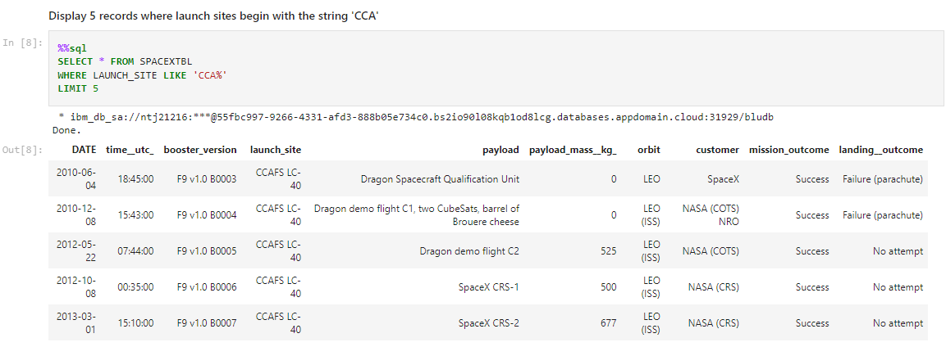
Launch Site Names Begin with 'CCA'
Where launch_site like 'cca%’ looks for cca and anything after because of the % symbol.

Slide 26
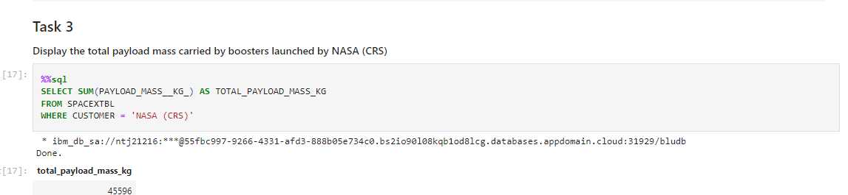
Total Payload Mass
WHERE CUSTOMER clause filters the dataset to only include NASA flights

Slide 27
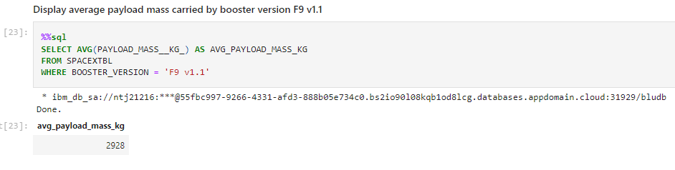
Average Payload Mass by F9 v1.1
WHERE BOOSTER_VERSION clause limits to the F9 v1.1 booster type

Slide 28
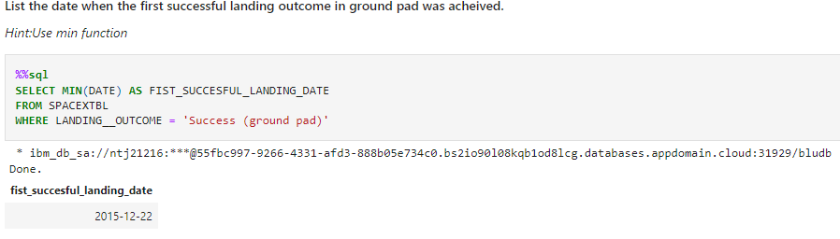
First Successful Ground Landing Date
WHERE LANDING_OUTCOME = Success (ground pad) limits the results returned to successful landings on a ground pad.

Slide 29
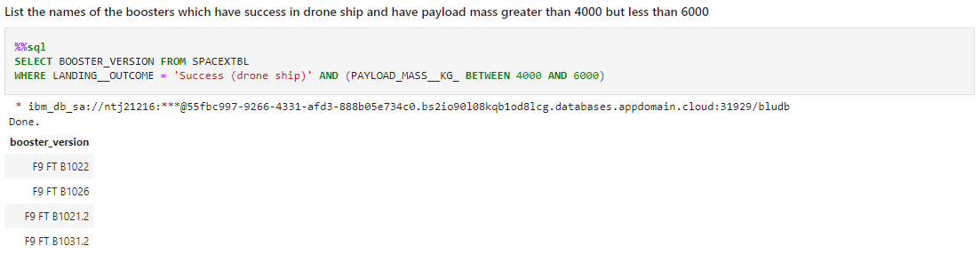
Successful Drone Ship Landing with Payload between 4000 and 6000
SELCET calls the list names of boosters. WHERE specifies which have successfully landed on drone ship, AND limits results to payloads which had a mass greater than 4000 but less than 6000

Slide 30
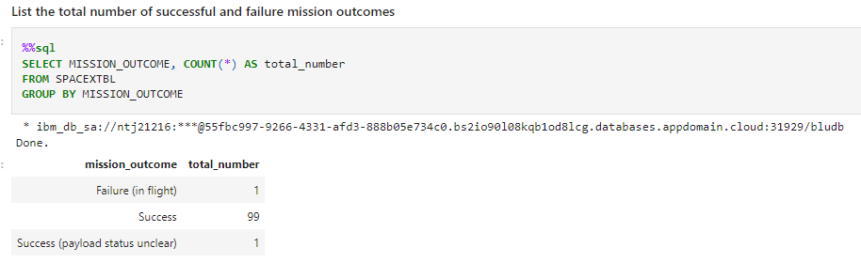
Total Number of Successful and Failure Mission Outcomes
COUNT calculates the total number of successful and failure mission outcomes

Slide 31
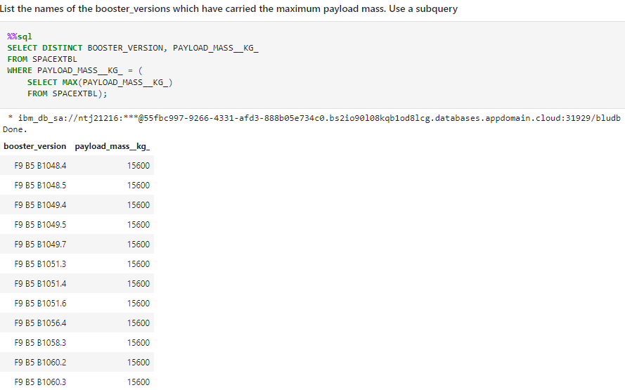
Boosters Carried Maximum Payload
SELECT lists the names of the boosters, WHERE and SELECT MAX filter to those which have carried the maximum payload mass

Slide 32
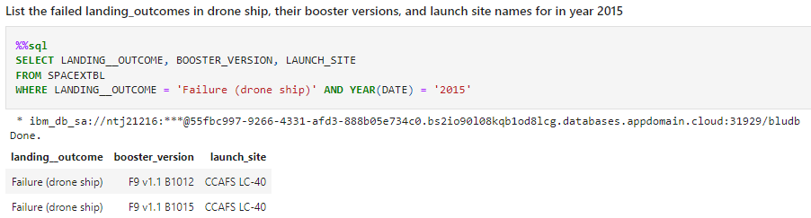
2015 Launch Records
WHERE LANDING_OUTCOME lists the failed landing outcomes in drone ship, their booster versions, AND YEAR(date) lifters launch site names for in year 2015

Slide 33
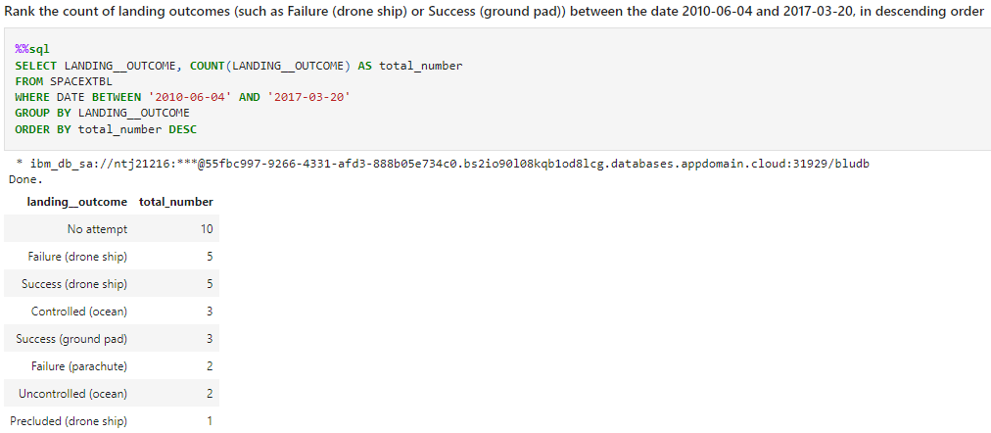
Rank Landing Outcomes Between 2010-06-04 and 2017-03-20
Rank the count of landing outcomes (such as Failure (drone ship) or Success (ground pad)) between the date 2010-06-04 and 2017-03-20, in descending order

Slide 34


Slide 35
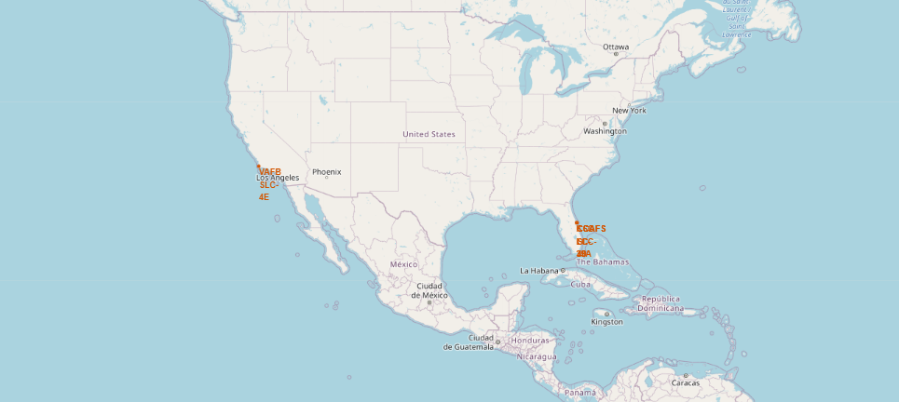
Folium Map showing SpaceX launch sites

Slide 36
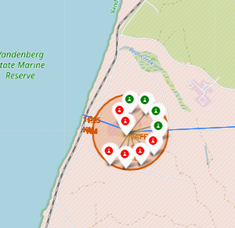
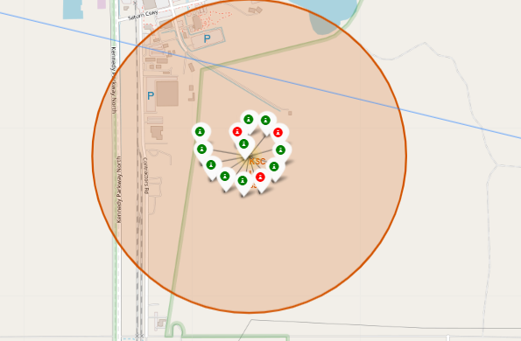
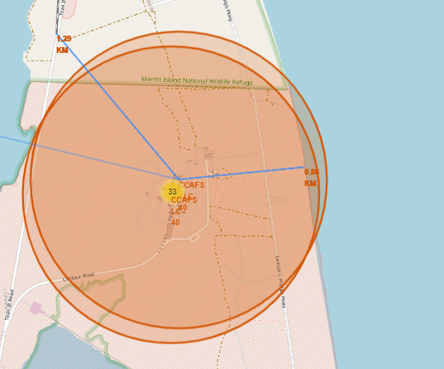
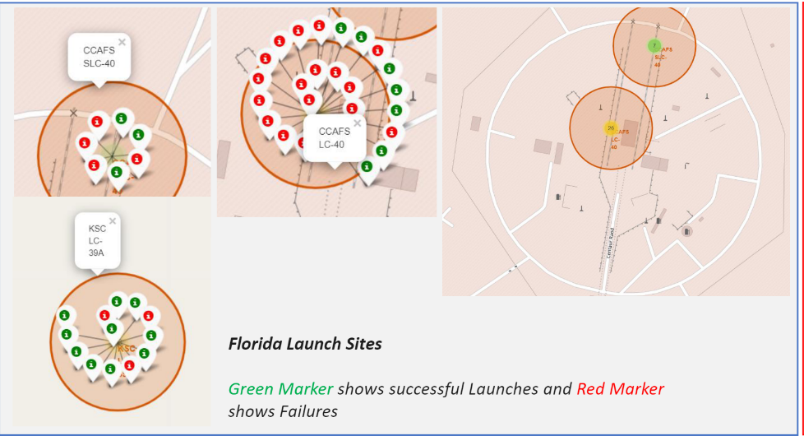
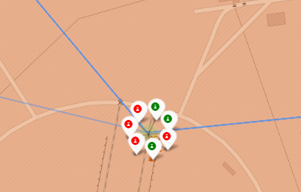
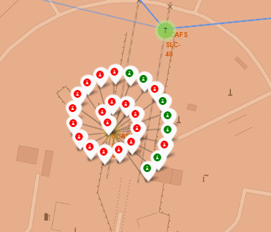
Folium Map showing Florida launch by mission outcome

Slide 37
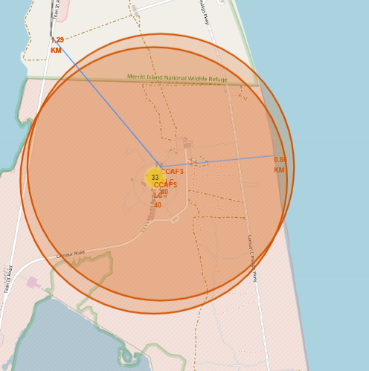
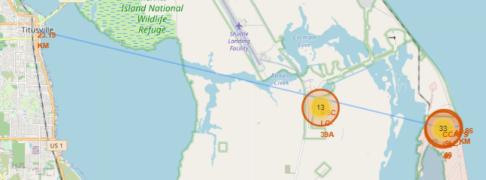
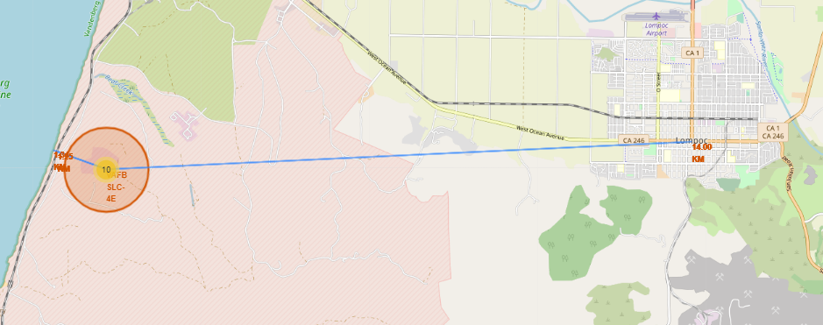
Folium Map showing proximity to landmarks
Are launch sites in close proximity to railways? Yes
Are launch sites in close proximity to highways? Not overly
Are launch sites in close proximity to coastline? Yes
Do launch sites keep certain distance away from cities? At least 14 miles

Slide 38


Slide 39
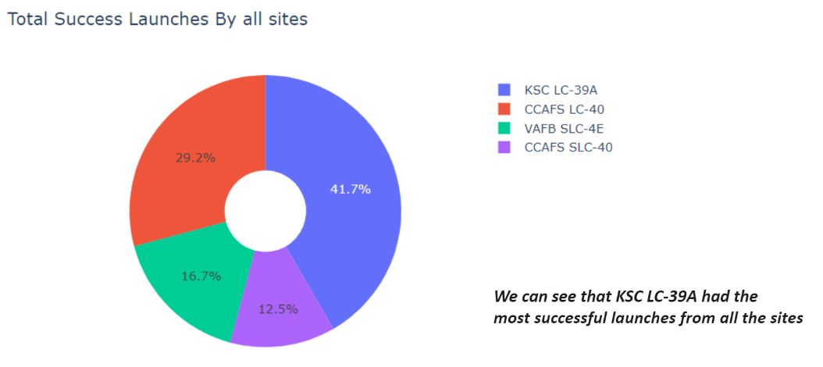
Pie chart showing count of success launches by site

Slide 40
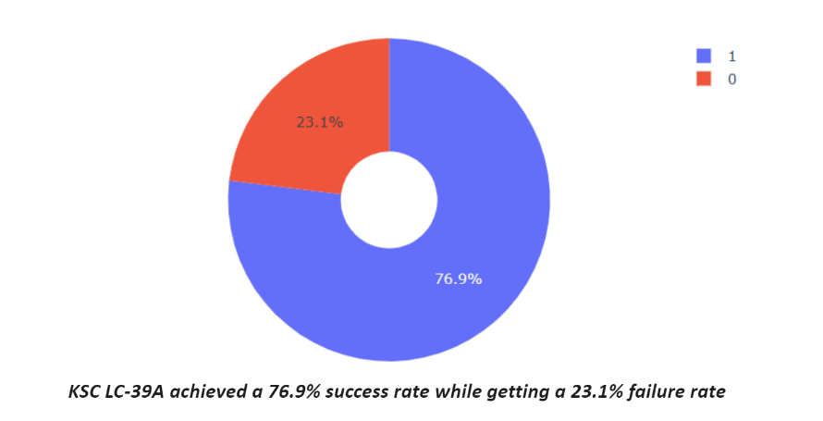
Pie chart for most successful launch site (KSC-LC39A)

Slide 41
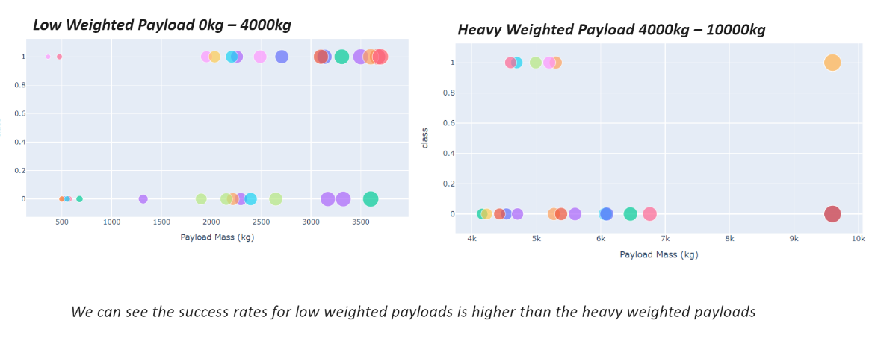
Graphs showing success rate vs payload mass (kg)

Slide 42


Slide 43
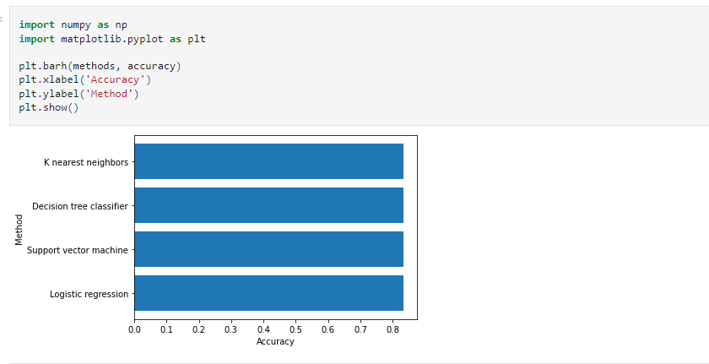
Classification Accuracy
The decision tree model had the highest accuracy with 0.889
https://github.com/pdee-design/IDM-data-science/blob/508bff4feb577973eba5ad05ce712ffa7826478b/%20Machine%20Learning%20Prediction%20lab.ipynb

Slide 44

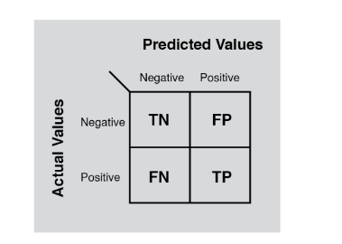
Confusion Matrix
The confusion matrix shows the actual vs ML predicted values, showing the accuracy of the model.

Slide 45
Conclusions
We have developed a model with an accuracy of 88.9% in predicting mission outcomes
We have learned what makes for a successful mission
We have developed out knowledge of SpaceX
We can now use this information to inform SpaceY as a competitor

Slide 46
Appendix
https://en.wikipedia.org/wiki/SpaceX
https://labs.cognitiveclass.ai/

Slide 47


